Slide 1
Subjective Test Progress of DASH
Liu Yitong, Shen Yun, Liu Hao, Ran Yu
WT&T Lab @ BUPT

Slide 2
Contents
Testing Preparation
Pre-test
Summary
Problems Found & Solutions
Formal Test
Testing Progress
Primary Results
Problem

Slide 3
Testing Preparation
Tester Organization
60 testers are divided into 3 groups(A, B, C).
Each tester will watch about 45 test video clips.
Evaluation Forms are same with UCSD’s.
Testers’ Information will be recorded.
Schedule
It takes more than one hour for every test process.
We could test 3 people at a time.
Test Number | Name | Gender | Age | College | E-mail
Notes:
这个表格要加么？

Slide 4
Summary of Pre-test
Testing Purpose
To find out the drawbacks of our test scheme and try to solve them.
To get familiar with the test process.
To collect testers’ feedback.
Content
Number of testers participated: 6 testers （10% of our planned testers）

Slide 5
Problems Found & Solutions
Existing Problems of the pre-test
The ratings of the first few videos are inaccurate (without standard test videos).
Testers have bias on different video content
Testers feel boring for watching the same content videos for a long time
Solutions (the modified test scheme)
Rearrange the video sequences for each test process
Give the testers clear instruction to keep an “average” expectation on videos with different content.
Increasing break times and break period during every test process.
Notes:
Solution里的rearrange是为了消除前几个视频打分不准确的情况，打乱视频的序列，让人测。但是刘浩他们在实际操作过程中发现这样做可行性比较低，效果也不太好。所以没有采取这个方法。我就标红了。下面是可行性低的原因：
1. 用重新排列视频顺序来消除没有满分视频的影响在目前情况下可行性比较低，需要给每个被试都单独重新安排一张测试表，而且被试在测试的时候还需要点来点去，在刚刚接触测试的时候很容易混乱，反而会适得其反，影响测试效果。还有一个原因就是这样做会增加不少的测试时间，按目前一个人一个多小时弄不完，现在的被试都是友情来测的

Slide 6
Formal Testing Progress
15 testers from BUPT are participated until now.
The group number of a tester was randomly selected.
Test results have been recorded into our forms.
Next Step
Solve the problems mentioned following.
Continue with our tests.

Slide 7
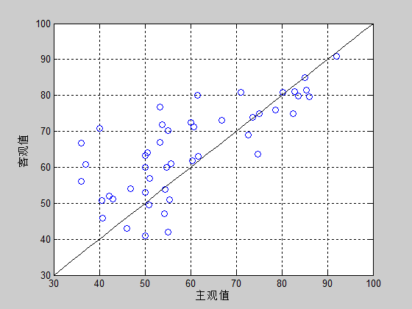
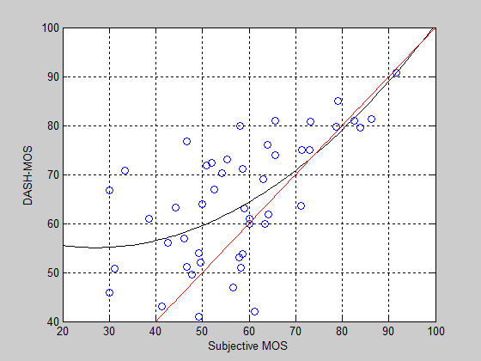
Primary Test Results
Videos: Bunny 1 - 11
Factor tested: I_{ST}
Testers: 15
Pearson Correlation: 0.9760.
Videos: Movie 1 - 48
Factor tested: I_{ID}, I_{ST}, I_{LV}
12 testers for each video
Pearson Correlation: 0.7397.
This is just a preliminary result. DASH-MOS will be more precise with the advance in our test.
Notes:
Movie 1-48:每个视频6个投票的话，相关系数0.6148；12个投票的话系数是0.7397。咱们就用12个投票的结果吧。

Slide 8
Problems
Time & Equipments — We could only test 3 people at a time because of the limitation of equipment, which will lead to a quite long period to finish the whole test.
Objective score of the videos — We need original UCSD score and I_{ID}, I_{ST}, I_{LV} as comparison to verify the accuracy of the model.
Standard test videos — Testers got some problem in scoring at the beginning without standard test videos.

Slide 9
Thank you

